Slide 1
Data Centric RAD
Bachelor of Science (Honours) in Computing in Software Development
Bachelor of Science in Computing in Software
Development
Department of Computer Science & Applied Physics

Slide 2
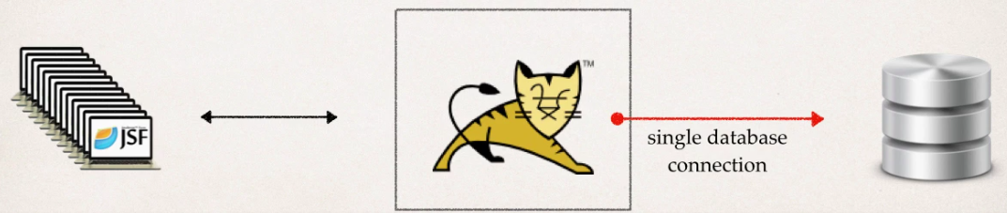
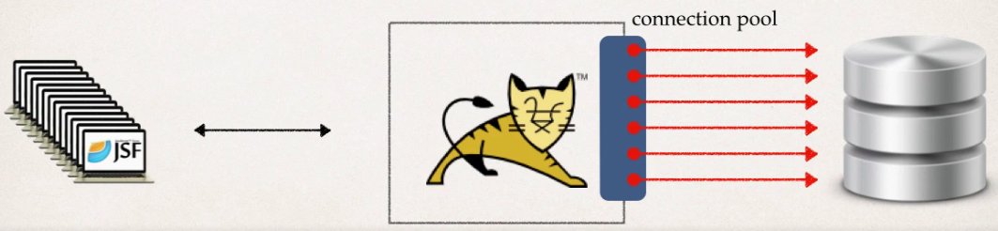
Database Connections in web apps
A single database connection will not scale for multiple users.
Use Database Connection Pools.

Slide 3
Database Connectivity in Tomcat
Download JDBC driver Jar file
Define Connection Pool in context.xml
Define resource reference in web.xml
Get Connection Pool reference in Java Code

Slide 4
1. Download JDBC driver Jar file
Download MySQL JDBC Driver from http://dev.mysql.com/downloads/mysql/ unzip it and put the Jar file in the WEB-INF/lib folder of your application.

Slide 5
2. Define Connection Pool in context.xml
WebContent/META-INF/context.xml
<Context>
<Resource name="jdbc/garage" auth="Container" type="javax.sql.DataSource"
maxActive="20" maxIdle="5" maxWait="10000" username="root" password="" driverClassName="com.mysql.jdbc.Driver" url="jdbc:mysql://localhost:3306/garage"/>
</Context>

Slide 6
3. Define resource reference in web.xml
WebContent/WEB-INF/web.xml
<resource-ref>
<description>Garage Datasource</description>
<res-ref-name>jdbc/garage</res-ref-name>
<res-type>javax.sql.DataSource</res-type>
<res-auth>Container</res-auth>
</resource-ref>

Slide 7
4. Get Connection Pool reference in Java Code
import javax.naming.Context;
import javax.naming.InitialContext;
import javax.sql.DataSource;
public class DAO {
private DataSource mysqlDS;
public DAO() throws Exception {
Context context = new InitialContext();
String jndiName = "java:comp/env/jdbc/garage";
mysqlDS = (DataSource) context.lookup(jndiName);
}
}

Slide 8
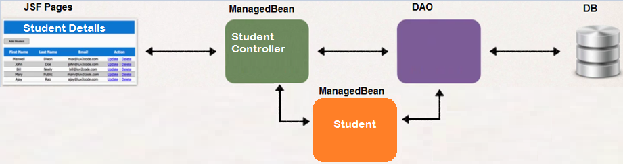
Using a DAO with a ManagedBean
Controller
Student ManagedBean - represents a Student object/table in DB.
DAO – DB helper code – communicates with DB via JDBC.
StudentController ManagedBean – Handles user actions in the view.
JSF Pages – Renders the information by calling the getter/setter methods on the ManagedBeans.
View
Model

Slide 9
Using a DAO with a ManagedBean
JSF has a Request Processing Lifecycle which means that for a given web request JSF will call getter methods on the ManagedBean.
These getter methods could be called multiple times so best practice is not to put intensive Database operations inside the getter methods.

Slide 10
Using a DAO with a ManagedBean
The Data Access via the DAO should only be done once per webpage – just before it is rendered.
This can be done by loading all data from the database in a method which is called only once before the page is rendered
<f:metadata>
<f:event type="preRenderView"
listener="#{superheroController.loadSuperheroes()}"/>
</f:metadata>

Slide 11
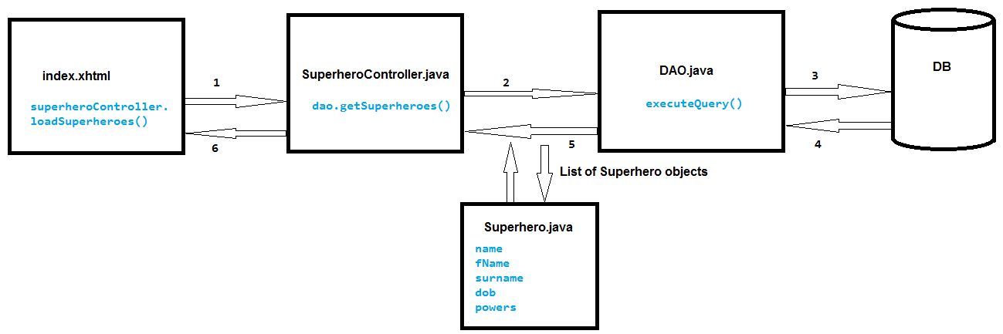
Using a DAO with a ManagedBean
ManagedBean
ManagedBean

Slide 12
Navigation from a Controller
In JSF views, we could specify where we wanted to navigate to:
<h:commandButton value="OK" action="employee_form_confirm"/>
This can also be accomplished in a Controller:
View
<h:commandButton value="Add" action="#{myController.add()}"/>
MyController
public String add() {
if (something) {
return "page1";
} else if (something else) {
return "page2";
} else {
return null;
}

Slide 13
Messages
h:messages tag shows all messages for a page.
<h:messages globalOnly="true" styleClass="error"/>
FacesMessage message =
new FacesMessage("Error: Cannot connect to Database");
FacesContext.getCurrentInstance().addMessage(null, message);

Slide 14
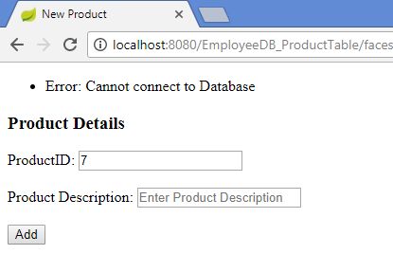
Messages

